Slide 1
Sri Lankan sign language recognition using convolutional neural network

Slide 2
Introduction
Hearing impairment is a disability that affects an individual’s ability to communicate using speech and hearing.
People who are affected by this disability use sign language as a media to communicate.
There remains a challenge for non-sign language speakers to communicate with sign language speakers.
A good Sign Language Recognition System can overcome the barriers exists between the non-sign language speakers and sign language speakers.

Slide 3
The focus of this research is to develop a software-based solution based on computer vision and deep learning that offers Sri Lankan sign language translation to text and speech thus aiding communication between Sri Lankan sign language speakers and non-sign language speakers.
This can be used as a personal Sign Language Interpreter or a personal translator for sign language users when communicating with non-sign language speakers.

Slide 4
Research Questions
What are the techniques that can make the best performance to bridge the communication gap between sign language speakers and non-sign language speakers?
What are the features that a hearing-impaired person (sign language speakers) expects from this application?
What are the features that a normal person (non-sign language speakers) expects from this application?

Slide 5
Research Objectives
To deliver excessive support by enabling hearing impaired people to communicate with others and actively interact with society.
To make Sri Lankan sign language speakers more comfortable in everyday life.

Slide 6
Limitations
Hard to recognize some signs because in Sri Lanka both the Sinhala and Tamil deaf community have the same sign for many concepts. Also, some concepts have more than one sign.
Lack of resources and data about Sri Lankan sign language. Sign Language Research Group is still conducting researchers on the similarities and dissimilarities of some signs.

Slide 7
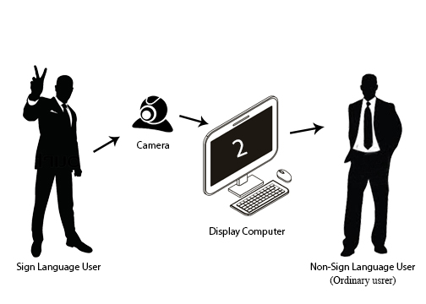
Methodology
High-level design

Slide 8
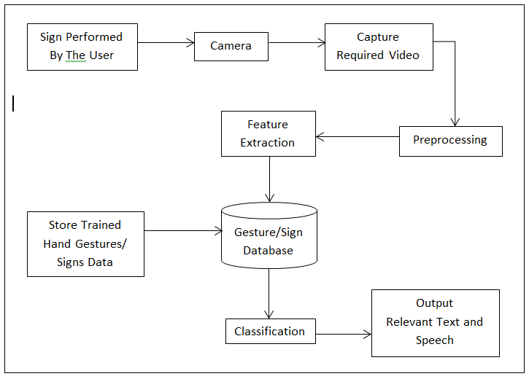
Proposed System

Slide 9
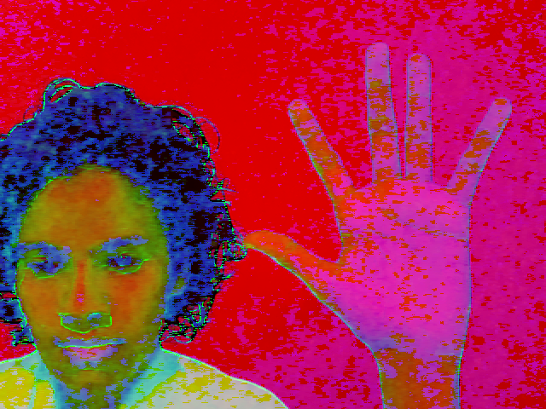
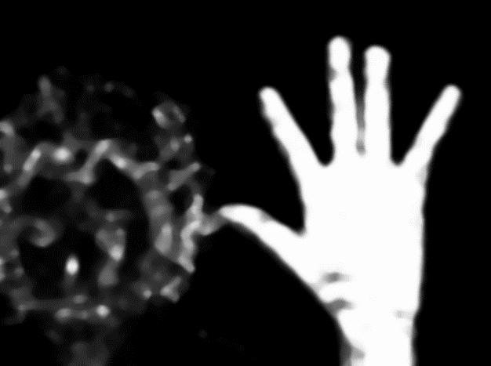

The hand region was selected using the HSV value selection. This detection method is independent with distance and background and the main segmentation method is color abstract which is getting the hand color pixels filtered.
Morphological operations were applied to each frame to remove the noise.

Slide 10
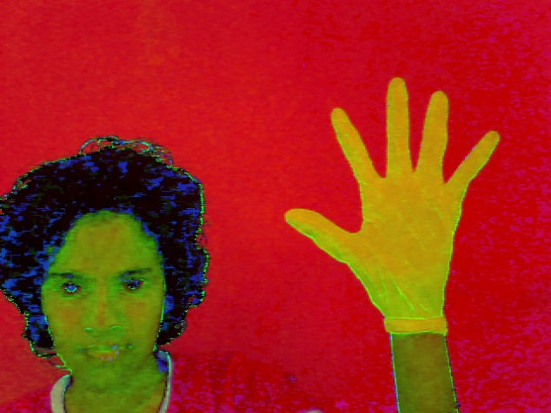


The same process was tested with plain color gloves. The segmentation of the hand was more accurate than the bare hand.

Slide 11
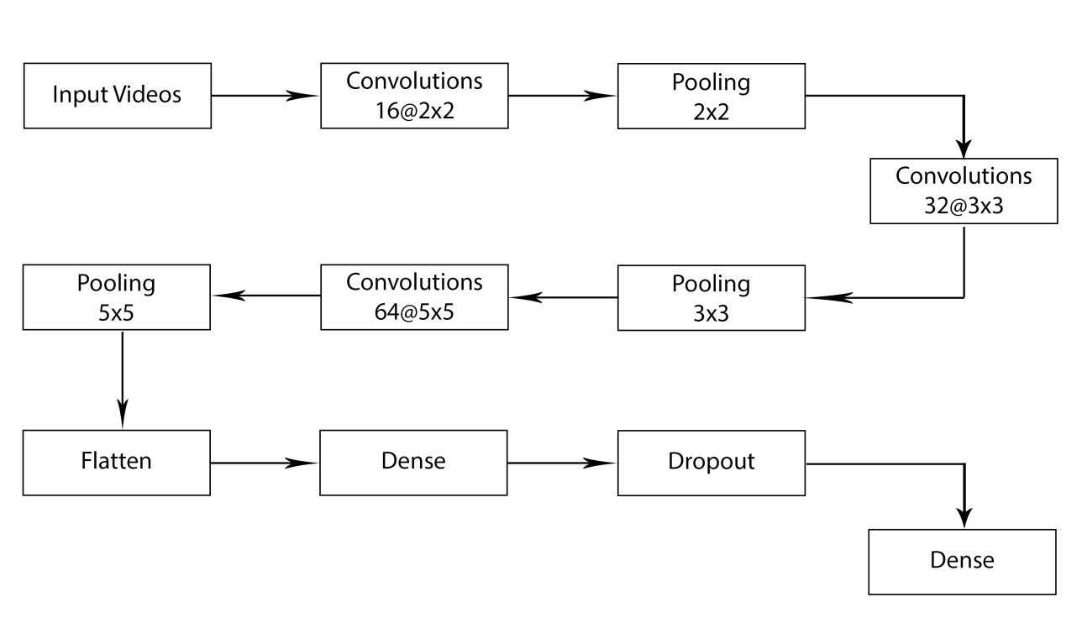
Convolutional Neural Network Model

Slide 12
Dataset
A primary dataset will be collected due to the unavailability of reliable sources.
Training set : 88000 samples
Validation set : 8800 samples
Testing set : 8800 samples

Slide 13
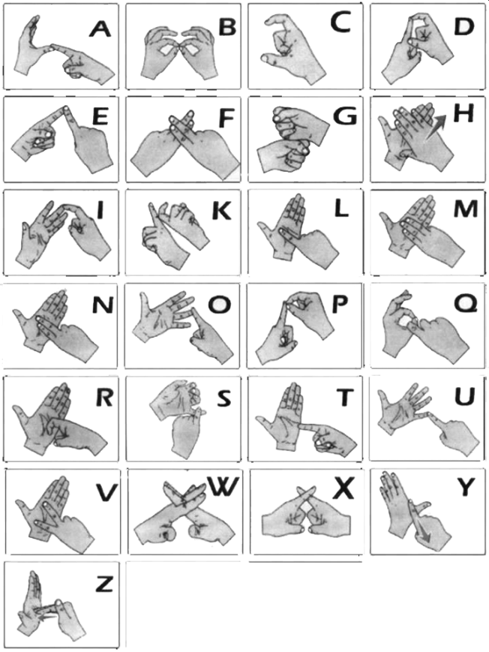
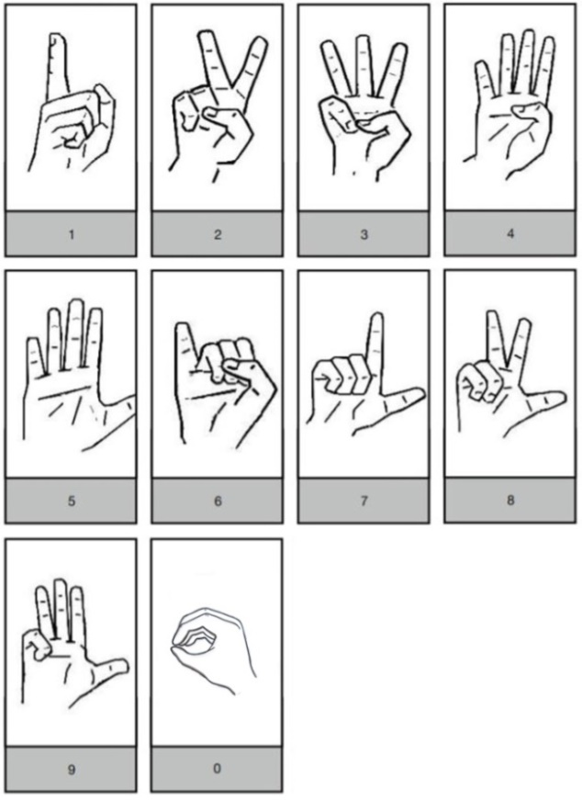
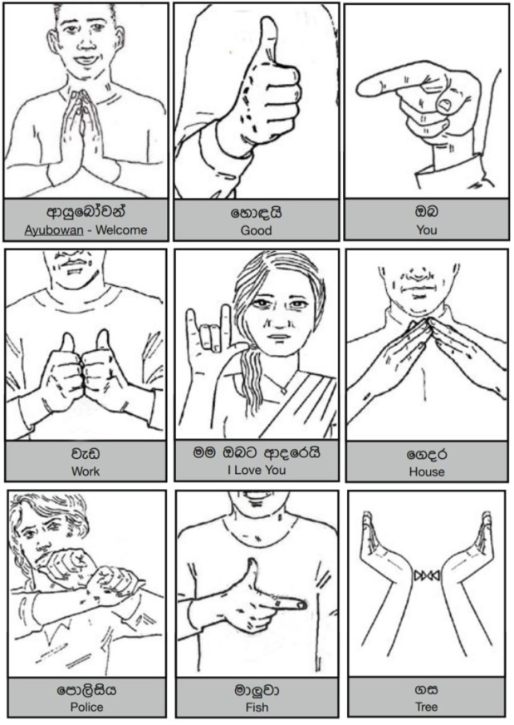
Selected Signs

Slide 14
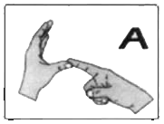








Samples of the dataset for letter A

Slide 15
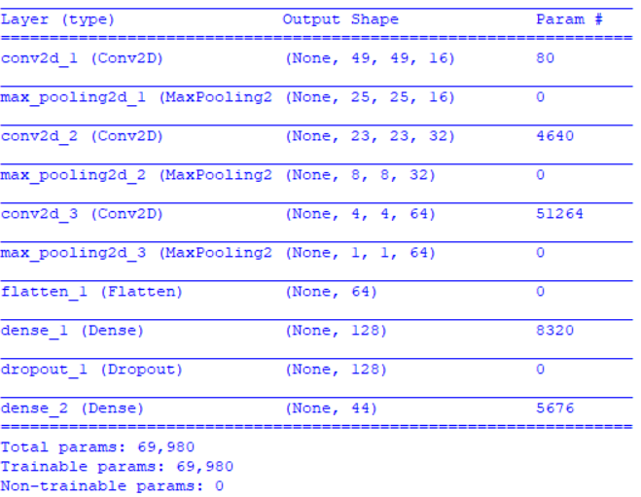
Summary of the trained model

Slide 16
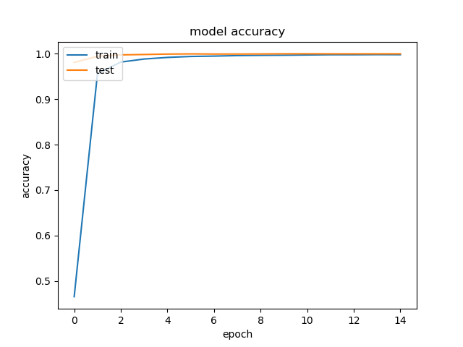
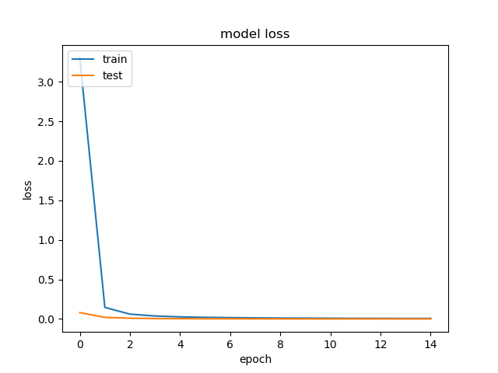
The validation accuracy is 99.97% and the error rate is 0.03% for the above dataset
The accuracy of the test set is 99.99% with a 0.01% error for the above dataset.

Slide 17
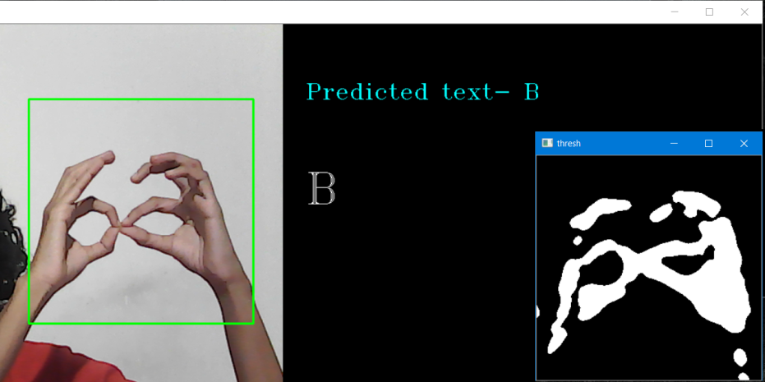
Tools and Technologies
The system was implemented using an Asus Y581V laptop with Intel Core i7-6700HQ processor, 8GB DDR4 SDTAM and NVIDIA GeForce GTX 950 GPU with 4096MB GDDR5 SDRAM.
The entire coding was done in the Windows environment using Python.
OpenCv,pyttsx3,TensorFlow and Keras libraries are used for the implementation.
Python IDLE 3.6.5 used as the IDE.

Slide 18
Conclusion
The proposed method of this research shows to have the potential in solving this problem using a simple camera if enough substantial training data is provided. Since more people have access to simple technologies this could contribute to a scalable solution.
The results of the implemented system have shown an accuracy rate of 99.97% for recognizing a selected set of signs, which has proven the suitability of the proposed methodology.

Slide 19
Future Work
Including more signs demonstrated through actions, movements and facial expressions.
Adding features to support all three main languages used in Sri Lanka which are Sinhala, Tamil, and English.
Deploy the project on the cloud and create an API for using it.
Incorporate feedback mechanisms to make the model more robust.
Add more sign languages.

Slide 20
Thank You

